Slide 1

INTERNATIONAL INSTITUTE OF INFORMATION TECHNOLOGY
Object Oriented Programming using C++
Project
Supermarket File Management System
Group 11
Neela Biswal(B215036)
Shreemoy Mishra(B215042)
Shubham Singh(B215053)
Y Shravanti(B215062)

Slide 2
Aim of the Project
To create a file management system for a supermarket.
To provide a user friendly methods to display, search, add or edit item details.
To provide appropriate functions for discount calculation.
To design a billing interface for shopping.
To provide the specific method linked with billing interface to check festive season discount.
To provide functions for display, add and edit festive seasons and view archived shopping details.

Slide 3
Backend
items.csv(read)
itemsdisplay.csv(read)
employeecredentials.csv(read)
dates.csv(read)
billdetails.csv(write)
Displaying and Billing
(access to files for only displaying and billing )
Employee
items.csv(read/write)
itemsdisplay.csv(read/write)
dates.csv(read/write)
employee.csv(write)
employeecredentials.csv(write)
billdetails.csv(read)
Complete File Management
( Privileged access for adding, editing, deleting)
Administrator

Slide 4
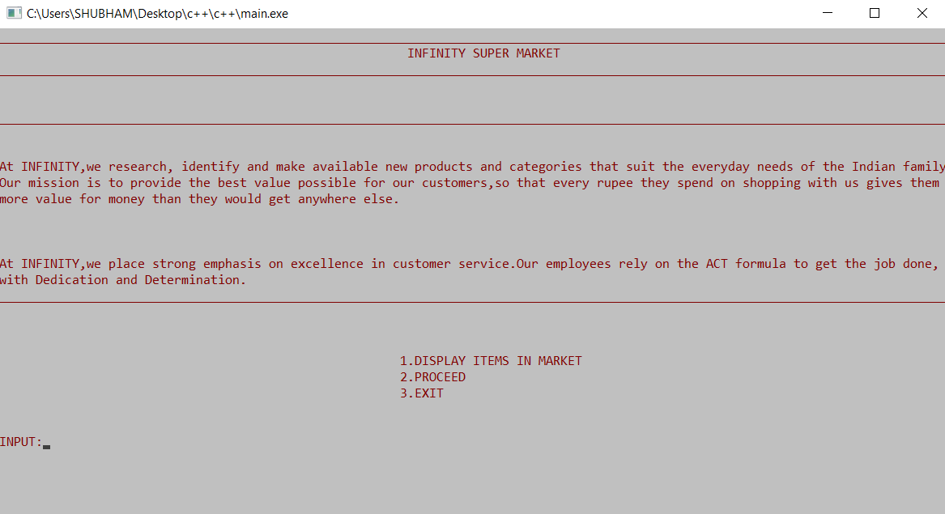
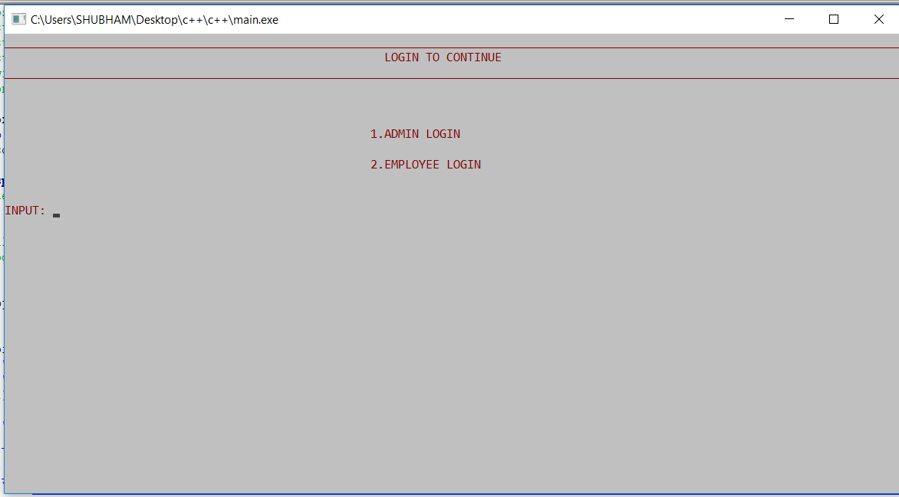
Project Details
‘displayitem( )’ function in class ‘item’ to display the items in supermarket by reading ‘itemsdisplay.csv’ file.
Login interface for employee and admin.

Slide 5
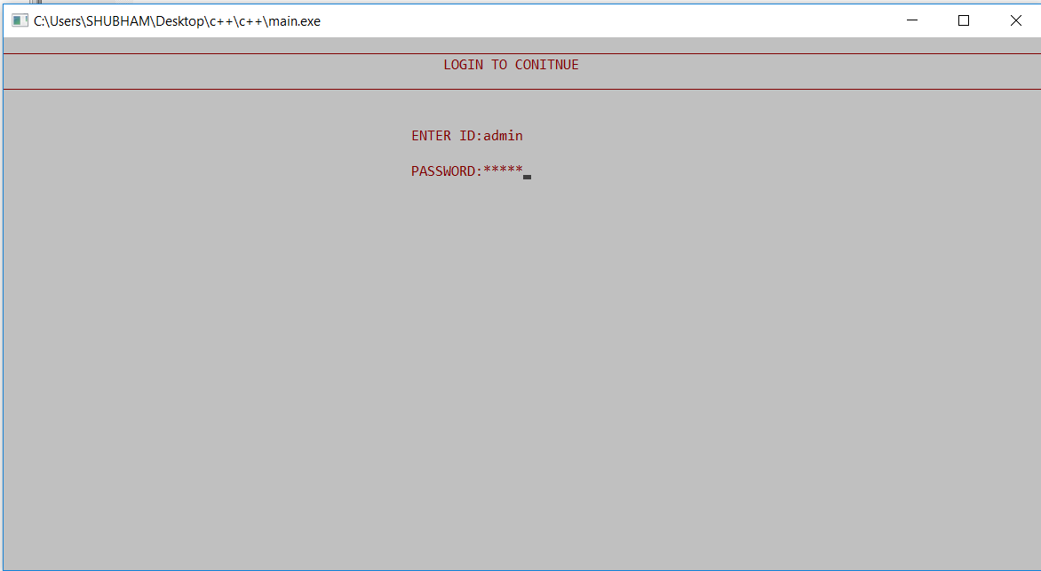
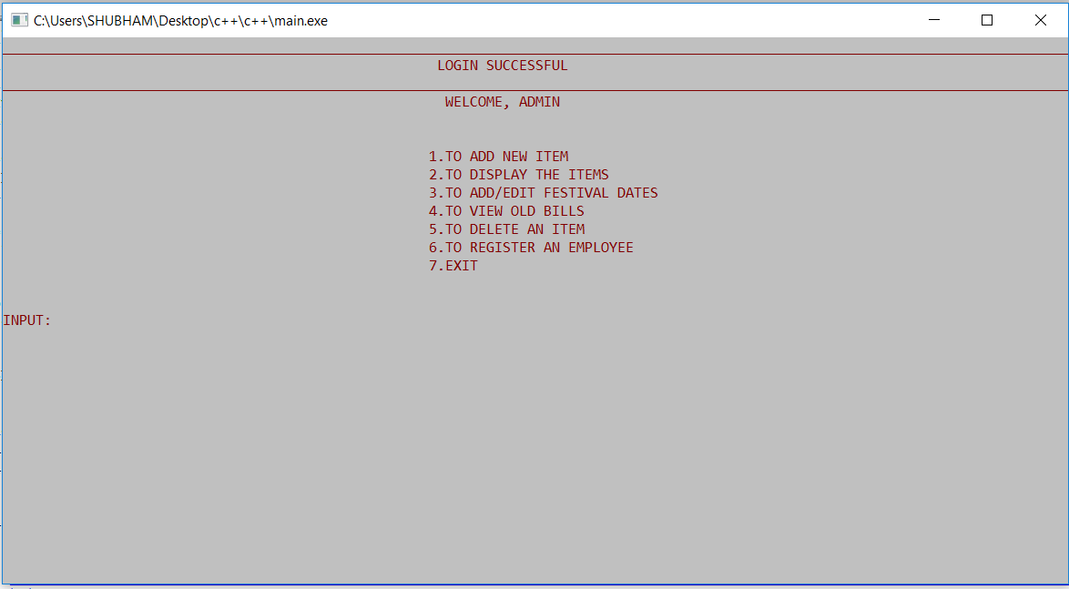
‘void admin(char id[ ],char pass[ ])’ function in class ‘login_interface’ matches the id and pass with the ‘admin.csv’ file’s id and pass.
Admin interface after successful login.

Slide 6
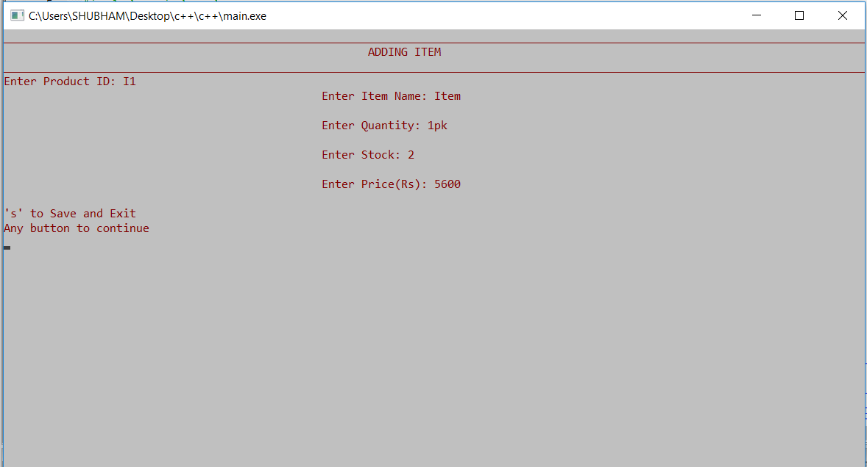
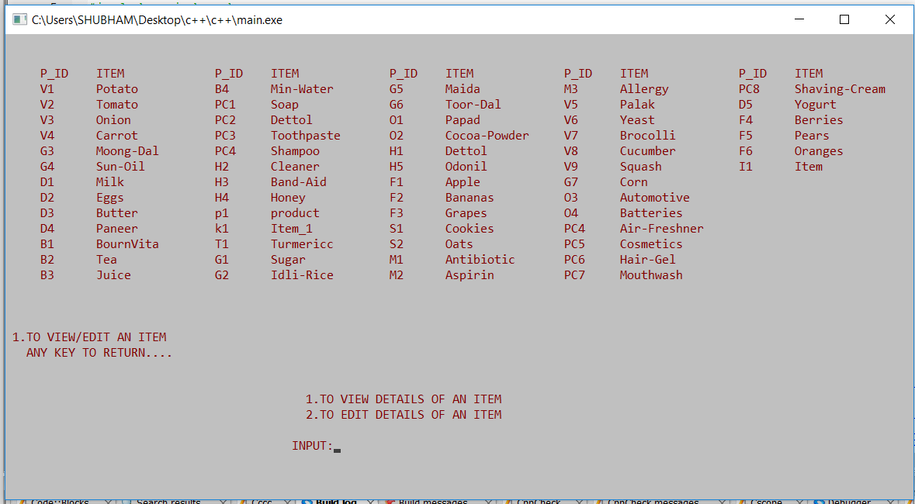
Adding new item calls ‘void edit( )’ function in class ‘item’ which checks for existing product id and then adds another item’s details in the ‘items.csv’ and ‘itemsdisplay.csv’ files.
Displaying of item is done in with ‘void displayitem( )’ function and further asked to view or edit the details of an item.

Slide 7
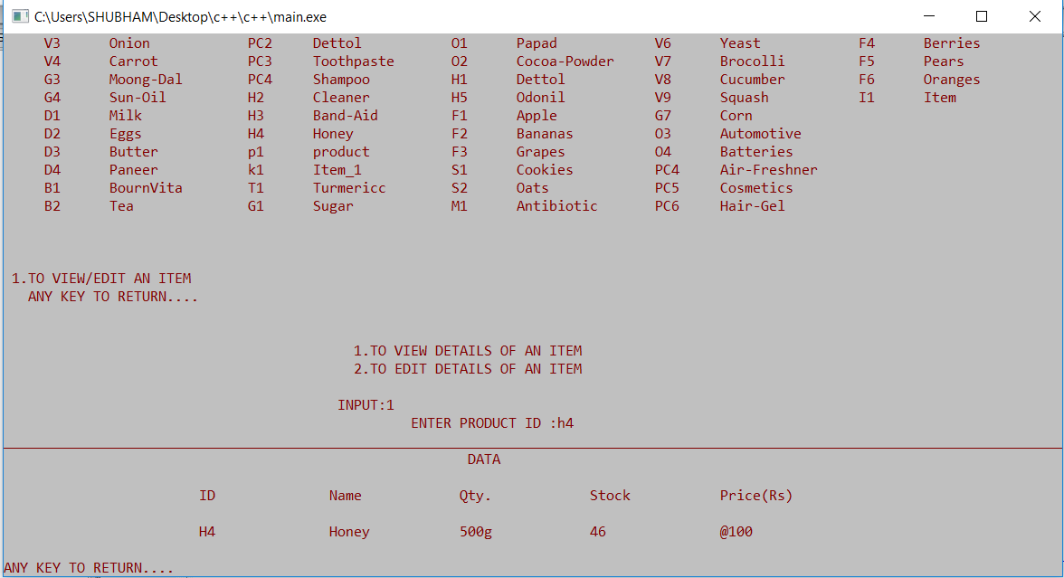
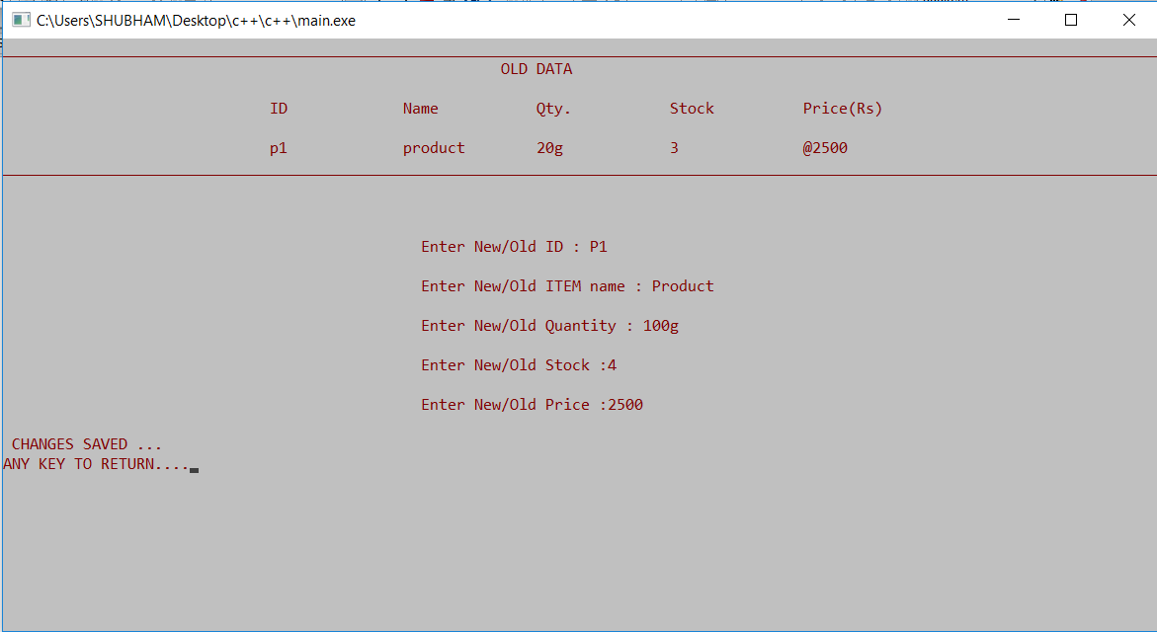
Details of an item is shown with ‘void edit(char x)’ (overloaded) function in class ‘item’ if (x=‘1’) with the help of ‘items.csv’ file details after product id is matched.
While editing of an item old details of an item is shown with ‘void edit(char x)’ function in class ‘item’ if (x=‘2’) with the help of ‘items.csv’ file details after product id is matched.

Slide 8
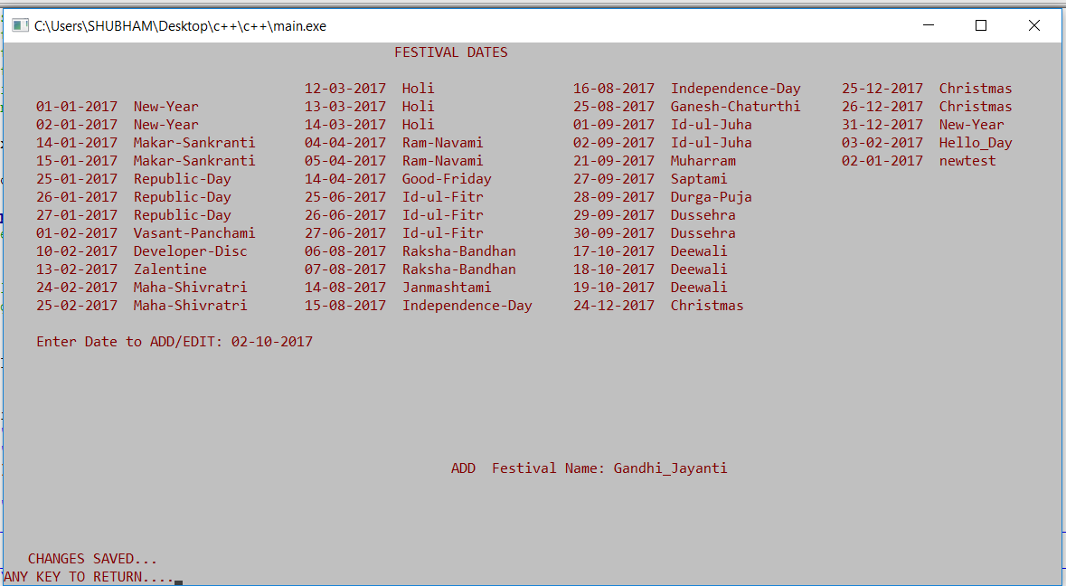
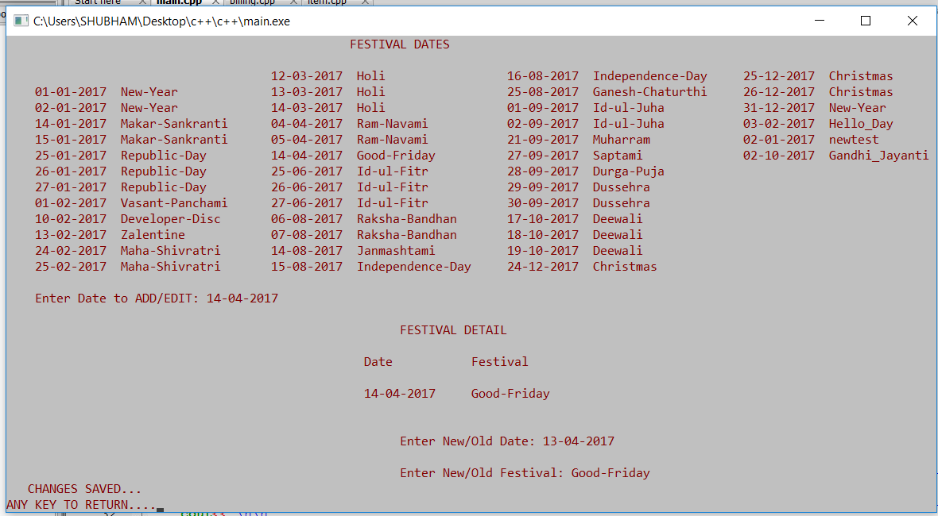
Discount dates displayed by ‘void display_date( )’ in class ‘cart’ (inherited from item), new festival date/name can be added for festive discount by ‘void edit_date( )’ function in class ‘cart’ (inherited from item) by adding details in ‘dates.csv’ file.
Existing festival date/name can be edited in same function by editing ‘dates.csv’ file.

Slide 9
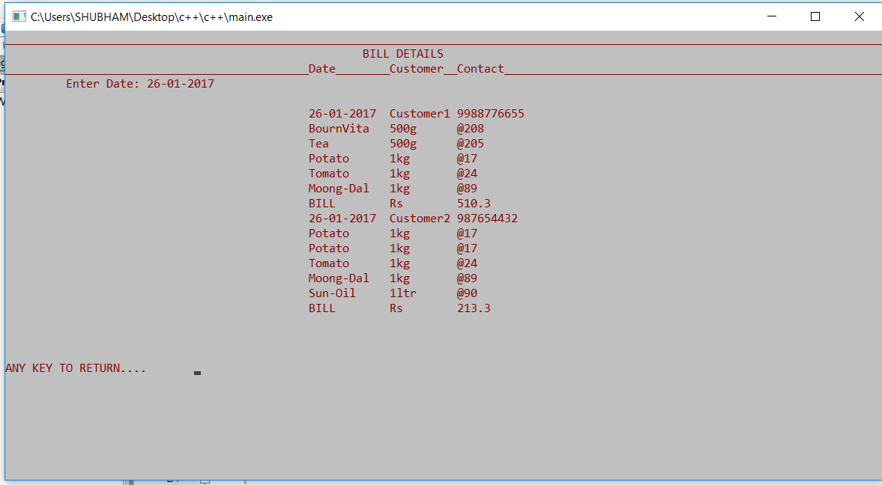
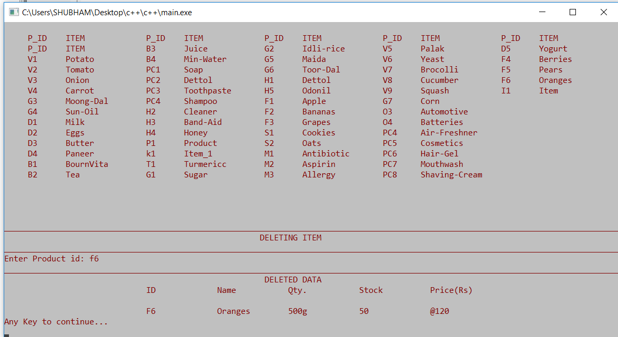
Bill Details according to the given date can be viewed by ‘void see_archived_details(char date[ ])’ in class ‘bill’ by accessing ‘billdetails.csv’ file.
Deletion of an item is done by ‘void remove_item(char pid)’ in class ‘item’ by editing ‘items.csv’ and ‘itemsdisplay.csv’ file.

Slide 10
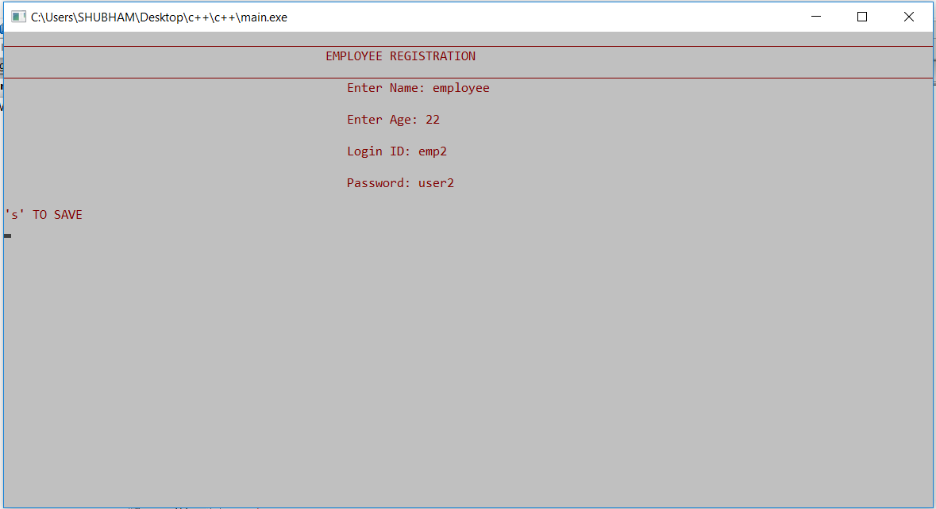
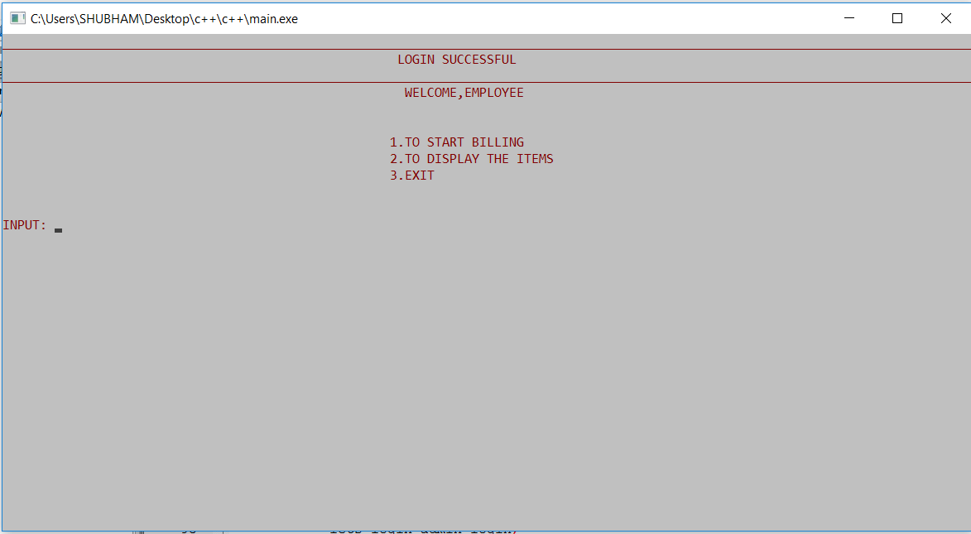
Employee registration is done by ‘void credentials( )’ function in class ‘login’ by adding details in ‘employees.csv’ file and its id and password in ‘employeecredentials.csv’ file.
For login ‘void employee(char id[ ], char pass[ ])’ function in class ‘login’ is used and details checked from ‘employeecredetials.csv’ file.

Slide 11
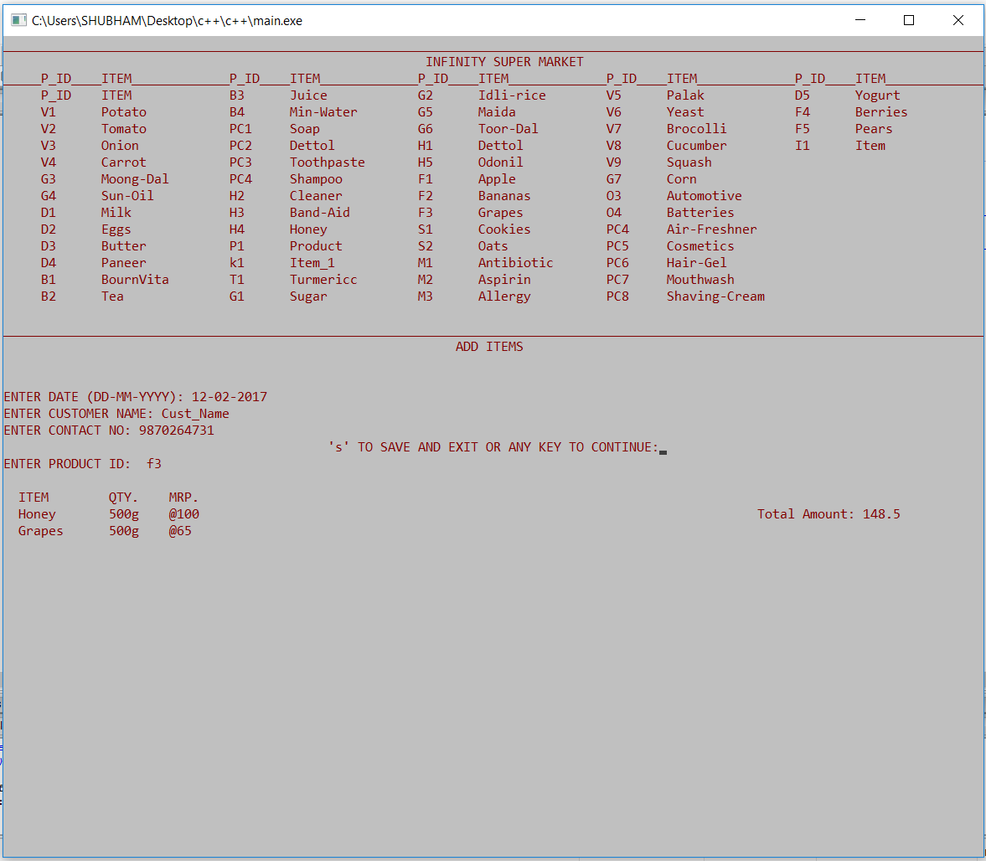
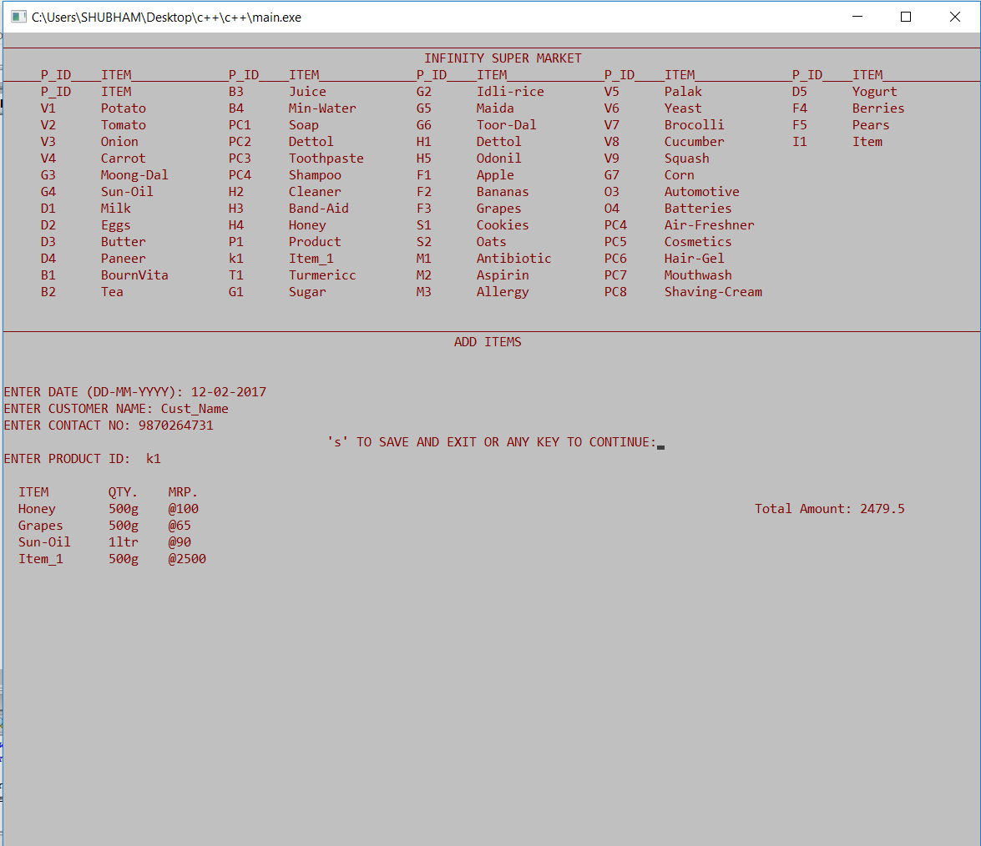
‘void billdetails( )’ function in class ‘bill’ is accessed and fetches item by accessing ‘double itemfetch( char pid[ ])’ in class ‘cart’ which returns the MRP of that item and is further passed to ‘double billamt(double mrp)’ of same class ‘bill’ which further returns new 10% discounted value and that is added to total bill.
Each time an item is fetched, above procedure repeats and total bill is updated.

Slide 12
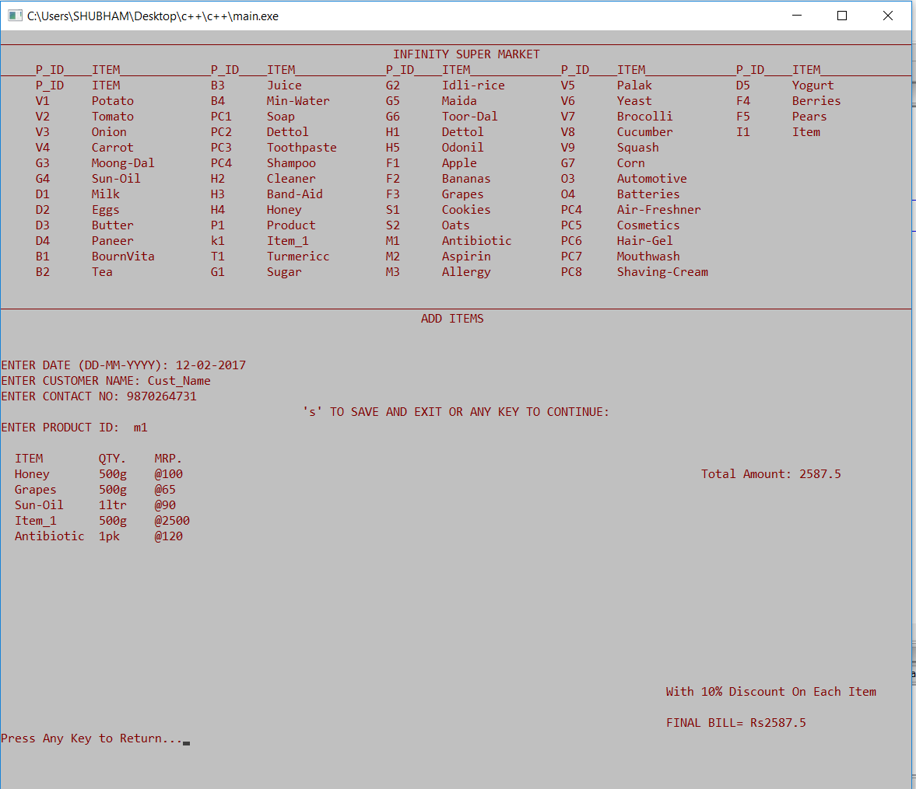
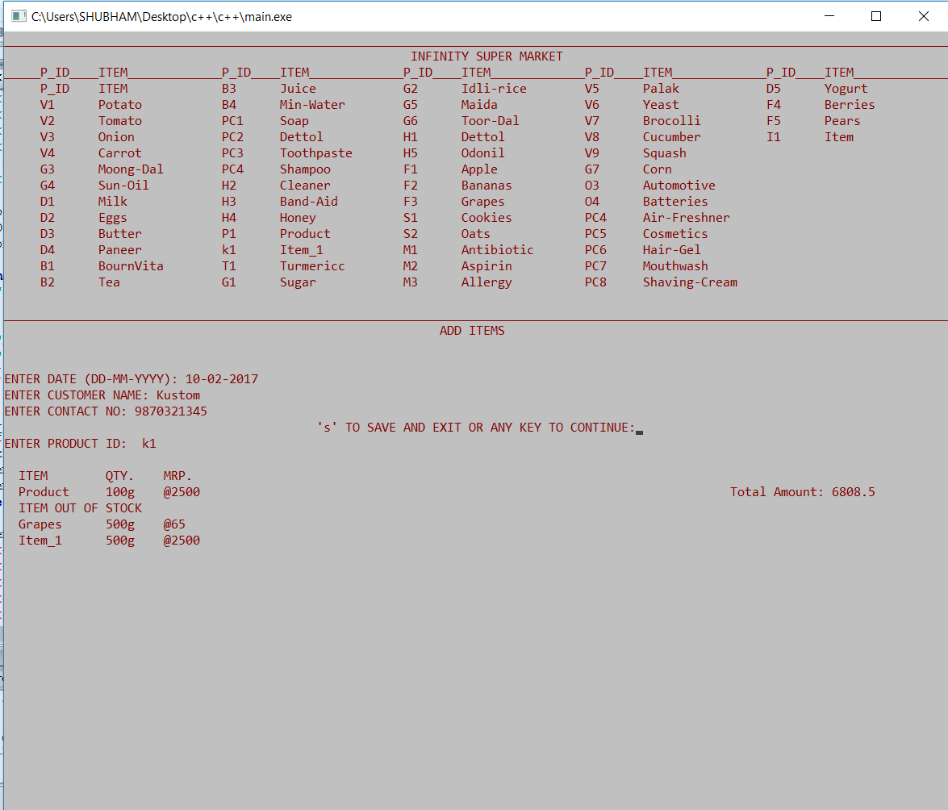
Total bill amount and date are passed to another function ‘void discount( double billedamt, char date[ ])’ in class ‘bill’ and further discount operations are checked depending on total bill amount and checking festive season date from ‘dates.csv’ file.
While fetching item ‘double itemfetch(char pid)’ also checks for the stock.

Slide 13
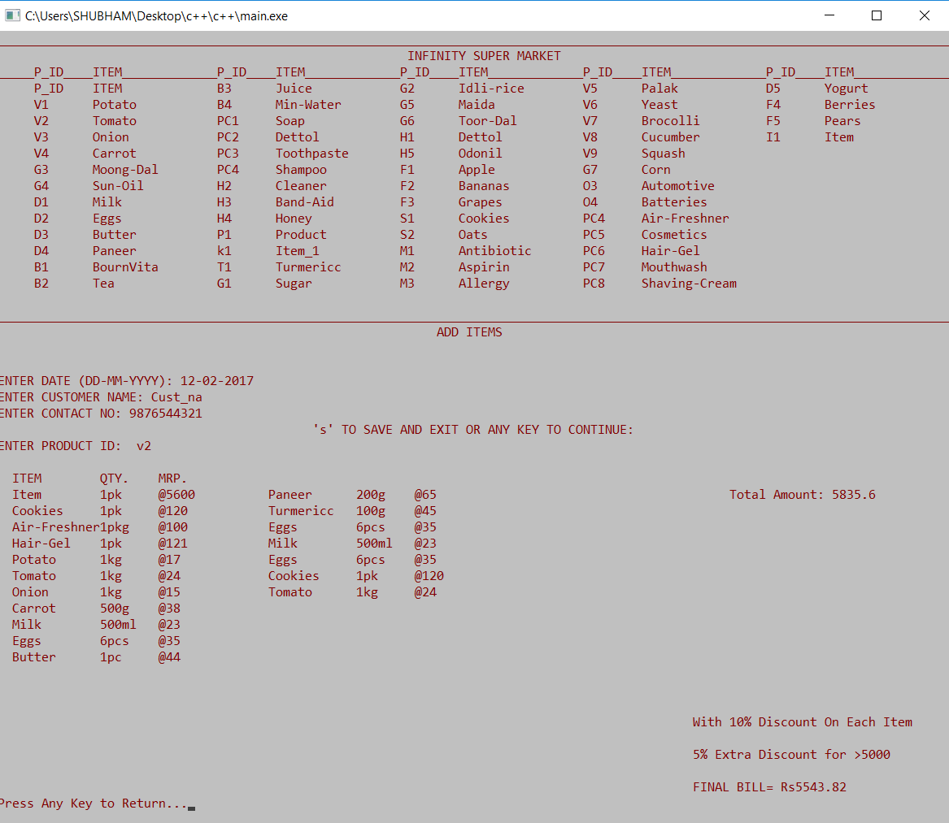
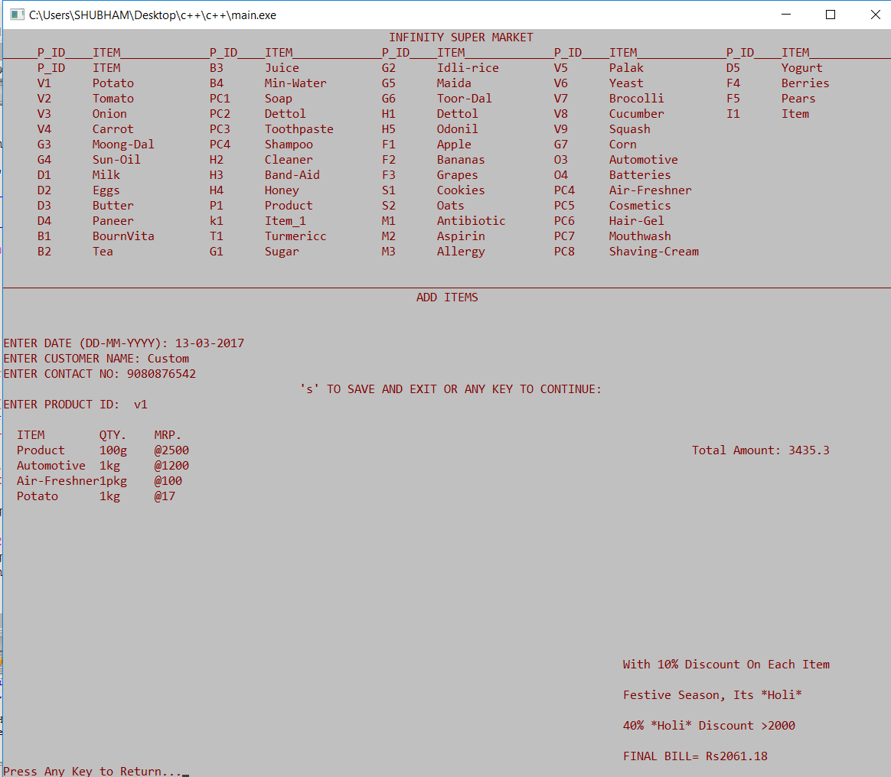
According to the total bill amount and after checking the festive season discount various types of discount are given.

Slide 14
Basic OOP features implemented
Data Abstraction and Encapsulation
Data abstraction and encapsulation are extensively used in our project. Classes like ‘item’ (for item specific details and implementations), ‘bill’(for bill related details and implementations).
Inheritance
For the shopping purpose derived class ‘addtocart’ is inheriting members from base class ‘item’.
Polymorphism
Static Polymorphism: In this project ‘edit( )’ function is overloaded for the purpose of editing and viewing detail of an item.
Dynamic Polymorphism: Virtual functions named ‘itemfetch( )’, ‘edit_date( )’, ‘display_date( )’.

Slide 15
Dynamic memory management is used while reading files, to save space and to reduce the reading time.
Administrator and Employee functions are segregated to avoid any type of data interference.

Slide 16
Thank You

